Slide 1
VQA Challenge and Visual Dialog Workshop

Slide 2
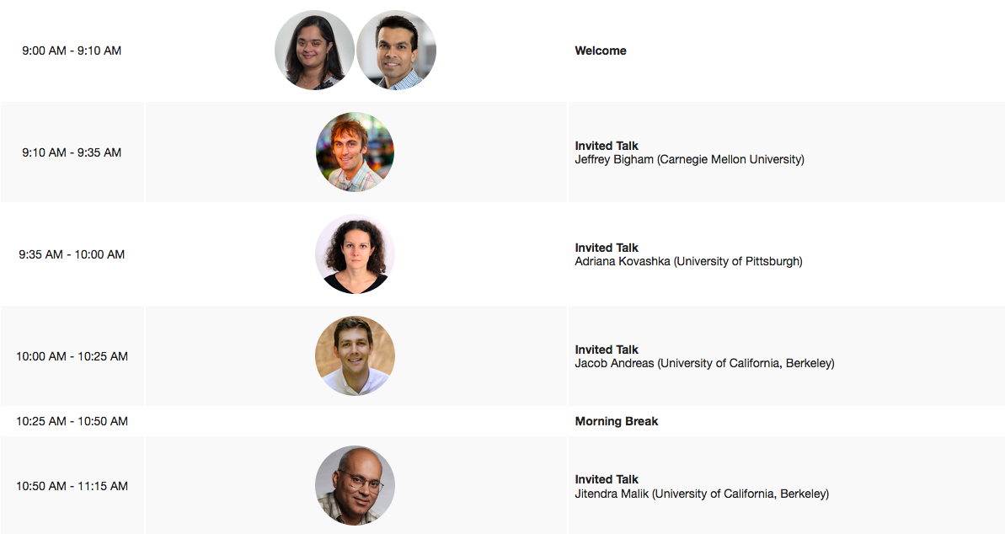
Agenda

Slide 3
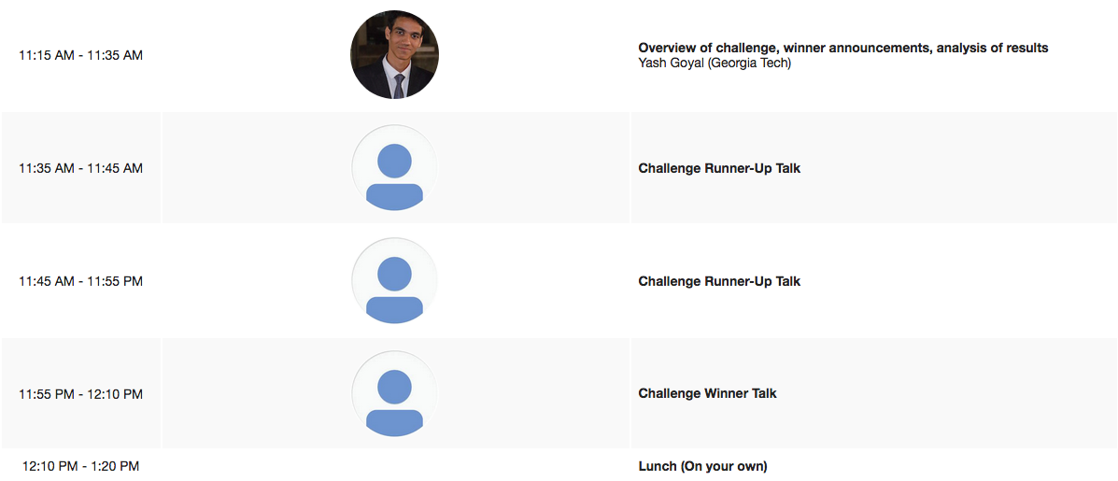
Agenda

Slide 4
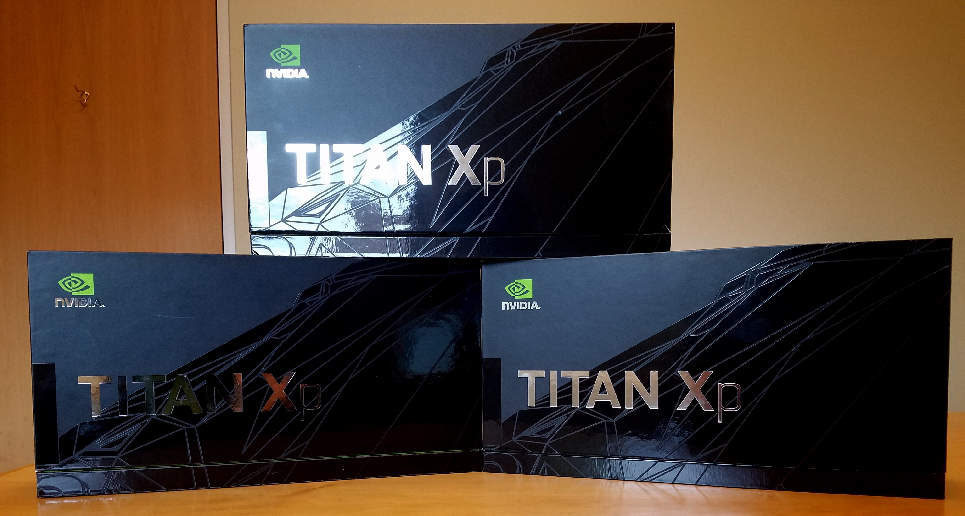
GPUs

Slide 5
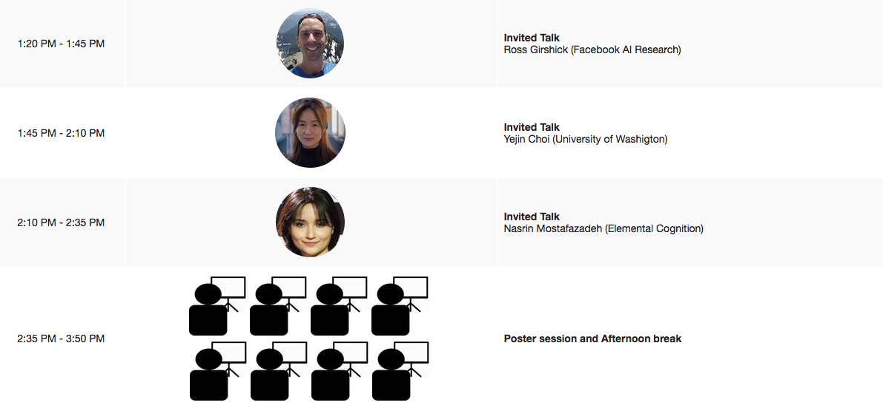
Agenda

Slide 6
Poster Presenters
Please set up your posters
in Hall A, 193-242
during the coffee break or lunch

Slide 7
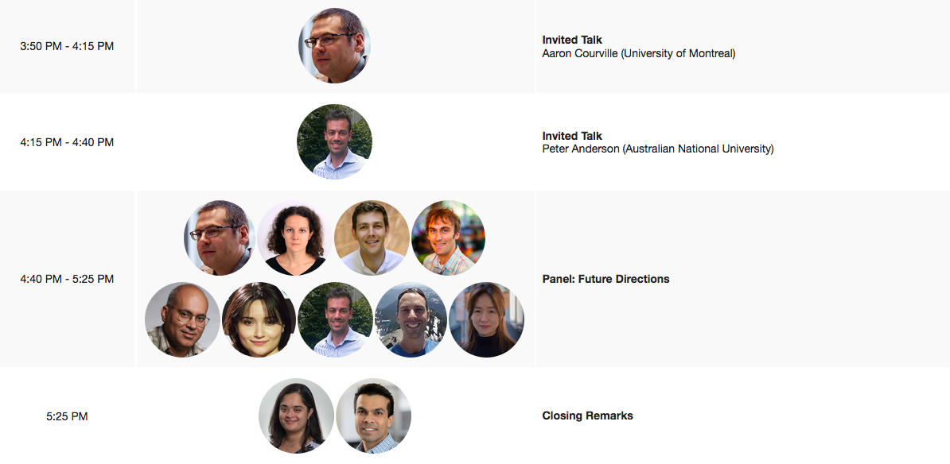
Agenda

Slide 8
This time we have mugs…

Slide 9
We got a little carried away…

