Slide 1
Evaluating state of the art in AI
Notes:
Hi, I’m Deshraj from CloudCV. CloudCV is an open source organization that aims to simplify the process of AI research. I’ll be talking about our latest project, EvalAI.

Slide 2
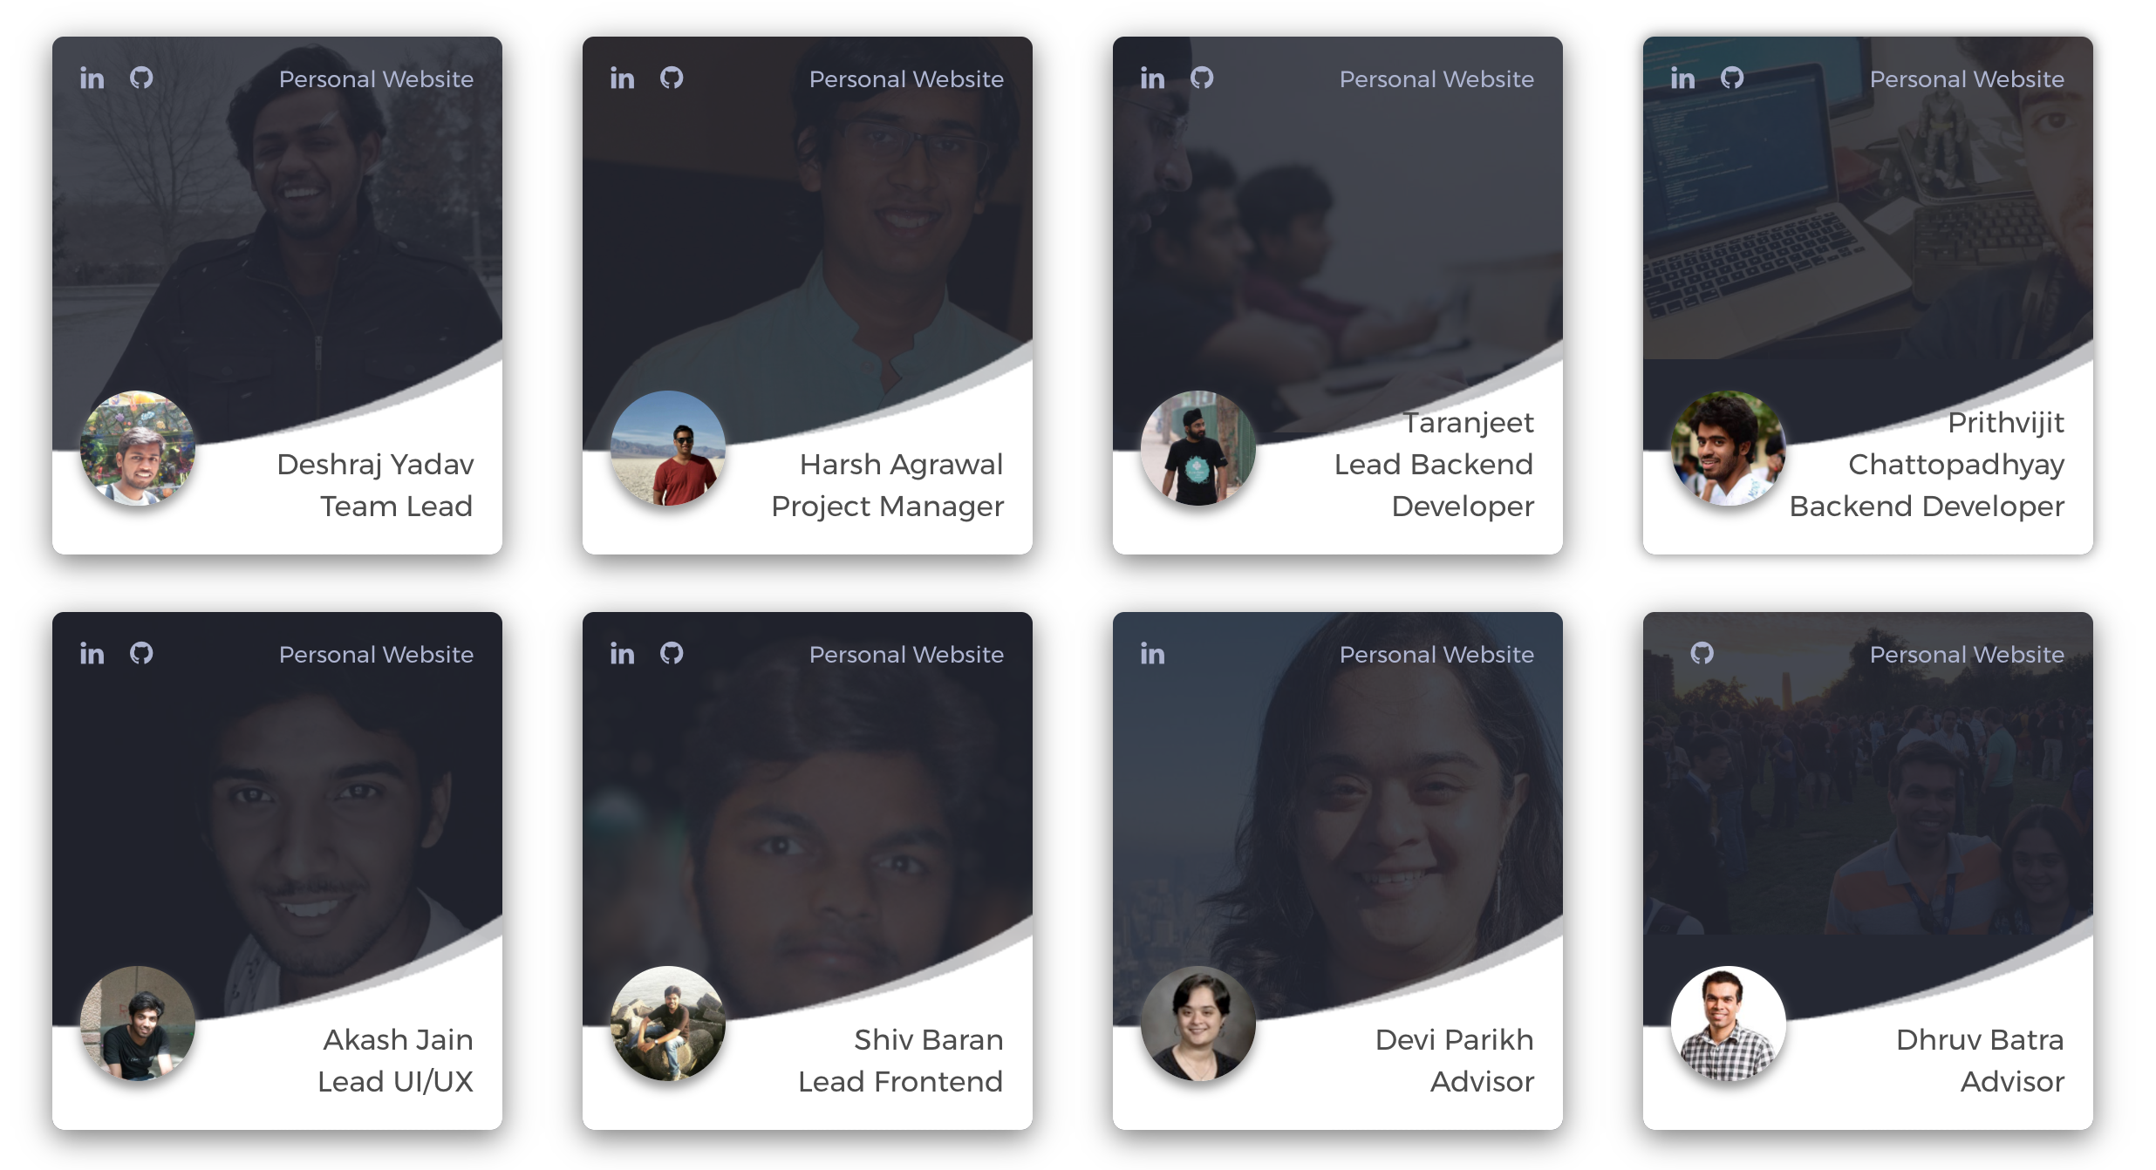
Team
and 30+ open source contributors
Notes:
This is our team. We are a group of graduate students, engineers and researchers supported by more than 30 open source contributors who are working with us on the project.

Slide 3
Benchmarking progress in AI is hard
Differences in algorithm implementation
Using different splits of the same dataset
Not using consistent evaluation metrics
Notes:
The problem: Benchmarking progress in AI is hard.
Comparing a new technique with existing approaches is a critical component of research. In a field as fast-moving as AI, such reproducibility is especially important.
However, it is becoming increasingly difficult to reproduce numbers from published papers, and to reliably compare new algorithms with existing approaches. Some common problems are: inconsistencies arising from differences in algorithm implementation, from using different splits of the same dataset, or not using the same evaluation metrics.

Slide 4
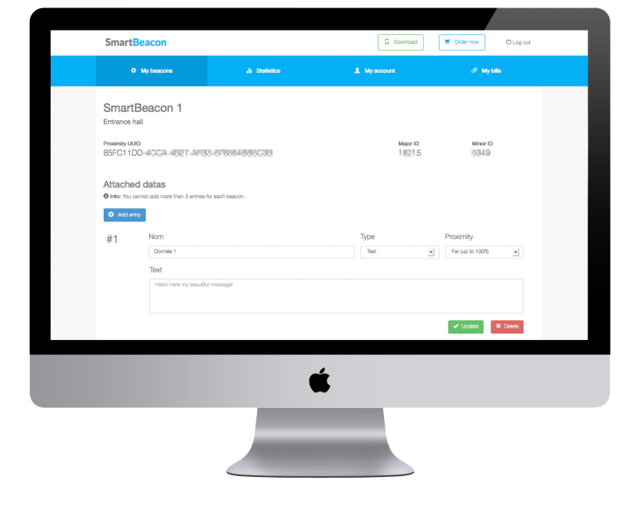
?
Notes:
To benchmark progress, hundreds of AI challenges have been proposed: In computer vision, we have challenges like imagenet and the MS COCO Challenges, in data science we have had the Netflix Challenge and the KDD cup, and so on.
However, a centralized platform to both host and participate in such challenges is still lacking.
change the size of squad dataset
move VQA image above
say imagenet instead of ILSVRC

Slide 5
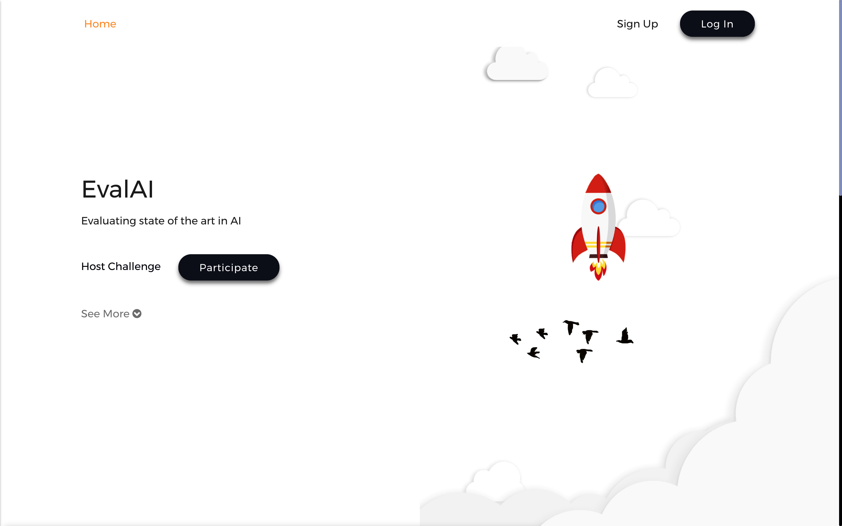
What is EvalAI?
https://evalai.cloudcv.org
Notes:
EvalAI is an open-source web platform that aims to evaluate the state of the art in AI. Its goal is to help AI researchers, and students to host, collaborate, and participate in AI challenges organized around the globe.

Slide 6
Wait, isn’t this just like Kaggle?
 | Kaggle | EvalAI
Challenge Platform
Generic Challenges
Custom Evaluation Protocols and Phases
Open Source
Portable Hosting
Notes:
A question we’re often asked is: Doesn’t Kaggle already do this? The central difference is this: On Kaggle, an AI researcher needs to choose from Kaggle’s predefined set of evaluation schemes: often that is just not enough. On the other hand with EvalAI, /any/ kind of challenge can be hosted.

Slide 7
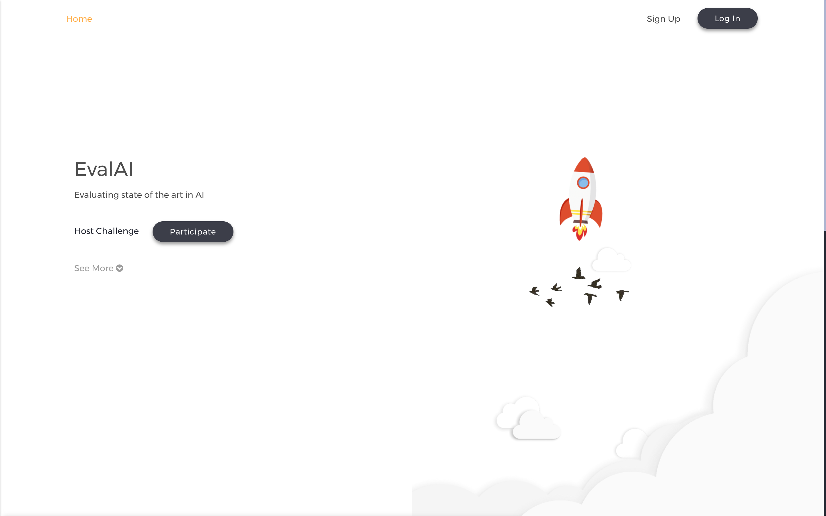
EvalAI
Host
Participant
Notes:
A challenge on EvalAI is designed around two entities: challenge hosts, and challenge participants. Now, I will be talking about some of the crucial features in EvalAI for both hosts and participants.

Slide 8
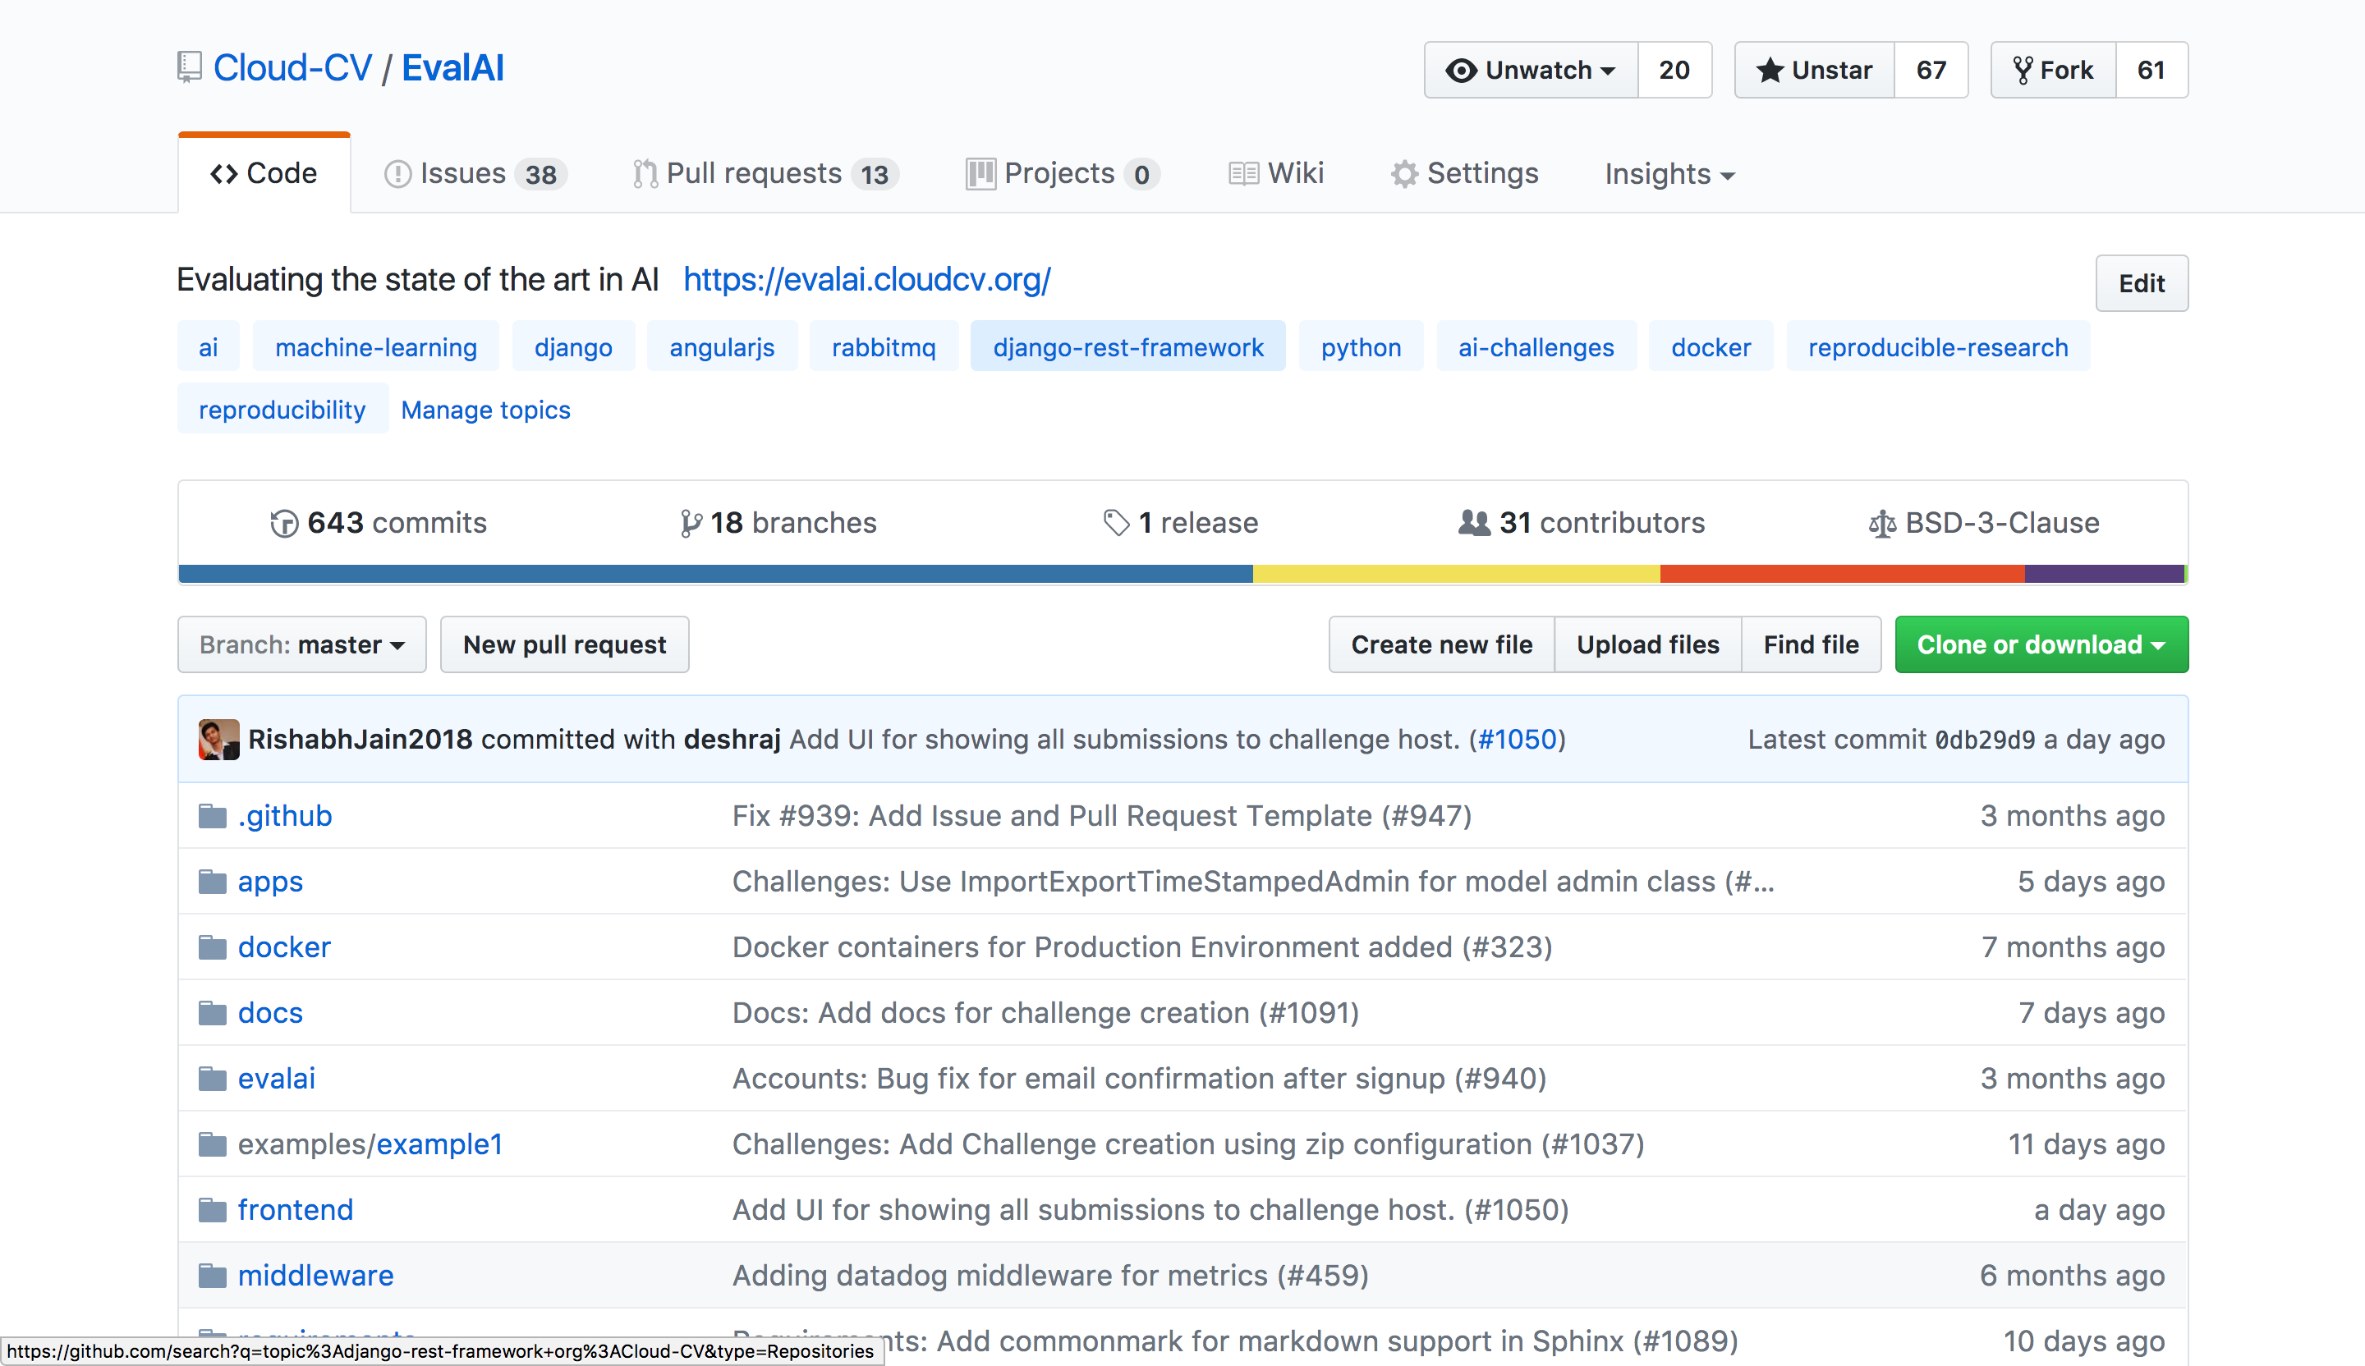
Host
Open Source
Link: https://github.com/Cloud-CV/EvalAI
Notes:
We have open sourced EvalAI so that the challenge hosts can deploy it on their own servers and run their challenges.

Slide 9
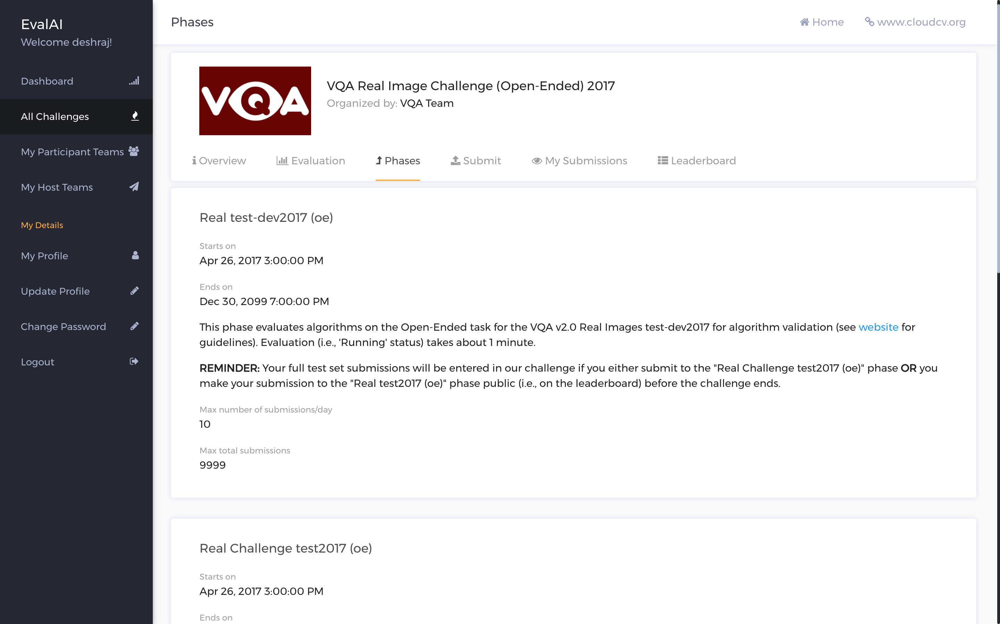
Host
Open Source
Custom Evaluation
Protocols and Phases
Notes:
We have designed a versatile backend framework that can support user-defined evaluation metrics and various evaluation phases for a single challenge.

Slide 10
Host
Open Source
Custom Evaluation
Protocols and Phases
Hosting is
simple
Hosting Challenge is
simple
Notes:
Hosting a challenge is streamlined. One can create the challenge on EvalAI using the intuitive UI or using zip configuration file.

Slide 11
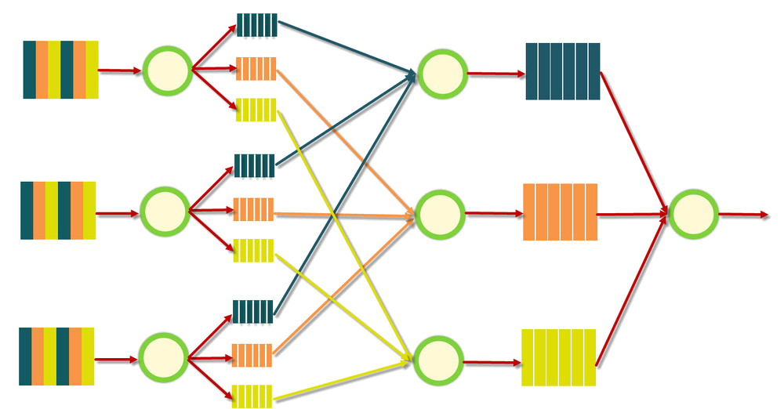
Participant
Fast Evaluation
MapReduce Job Execution: Logical View
Output
Map
Shuffle
Reduce
Notes:
For participants, EvalAI provides a swift and robust backend based on map-reduce framework that speed up evaluation on the fly. This makes it much faster for researchers to reproduce results from technical papers, and to perform reliable and accurate analyses.

Slide 12
Hosted on Codalab
Hosted on Codalab
Notes:
As its first challenge, EvalAI hosted this year’s VQA 2.0 challenge.
Some background: Last year, the VQA 1.0 challenge was hosted on Codalab, and on average evaluation would take 410 seconds.

Slide 13
Hosted on Codalab
Hosted on Codalab
Notes:
This year, the dataset for the VQA 2.0 challenge is twice as large. Despite this, we’ve found that our parallelized backend only takes a third of the time, which is a 6x speedup!

Slide 14
6x speedup
Hosted on Codalab
Hosted on EvalAI
Notes:
This year, the dataset for the VQA 2.0 challenge is twice as large. Despite this, we’ve found that our parallelized backend only takes a third of the time, which is a 6x speedup!

Slide 15
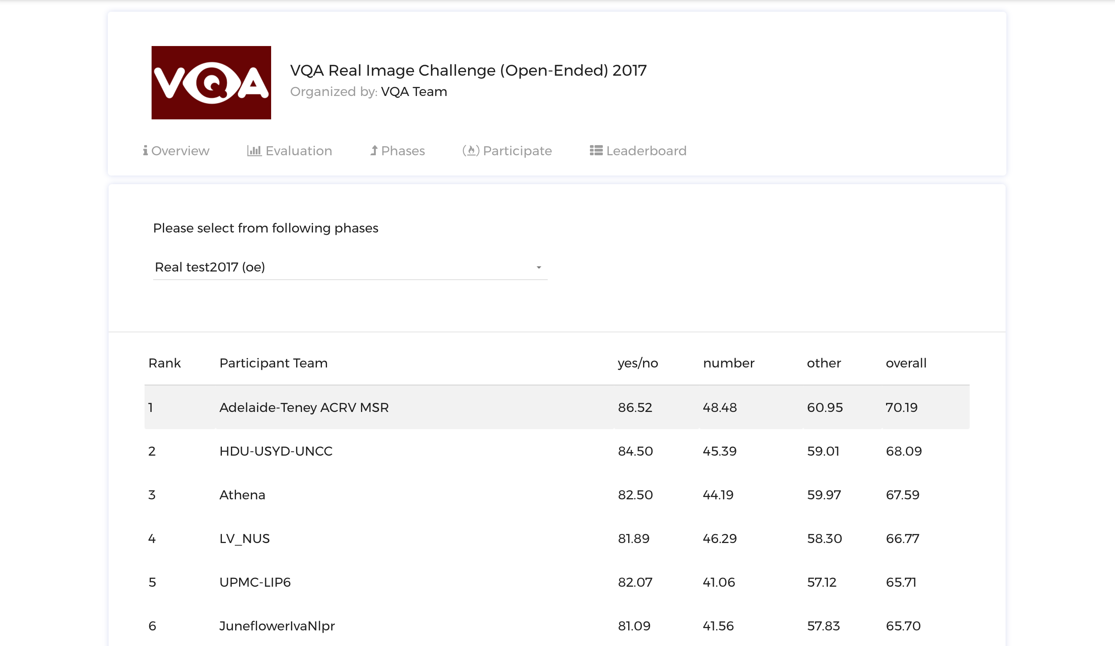
Participant
Fast Evaluation
Centralized leaderboards
VQA 2.0 Public Leaderboard
Notes:
On the front-end, we display centralized leaderboards that update in real time to help participants and organizers track progress.

Slide 16
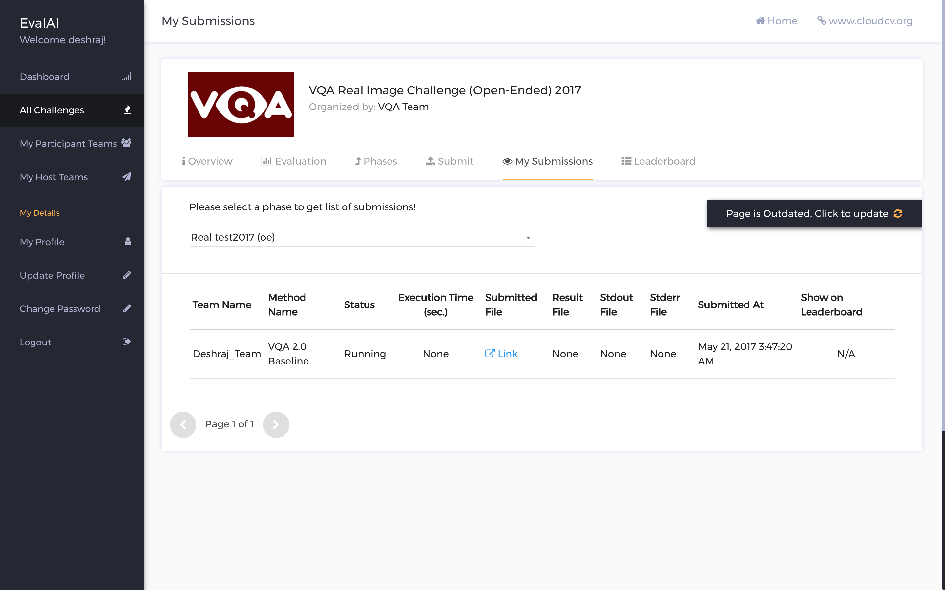
Participant
Fast Evaluation
Centralized leaderboards
Realtime updates
Notes:
Finally, we have designed a clean and intuitive user experience.
To top it all, EvalAI is completely open-source and so new features can easily be added by the community.

Slide 17
Progress
30+ Open Source Contributors
1100+ Github Issues & PR’s
3 times with Google Summer of Code
Notes:
Overall, we are building a centralized platform for all the AI challenges whether they are hosted on EvalAI or fork of EvalAI or as any other web application.

Slide 18
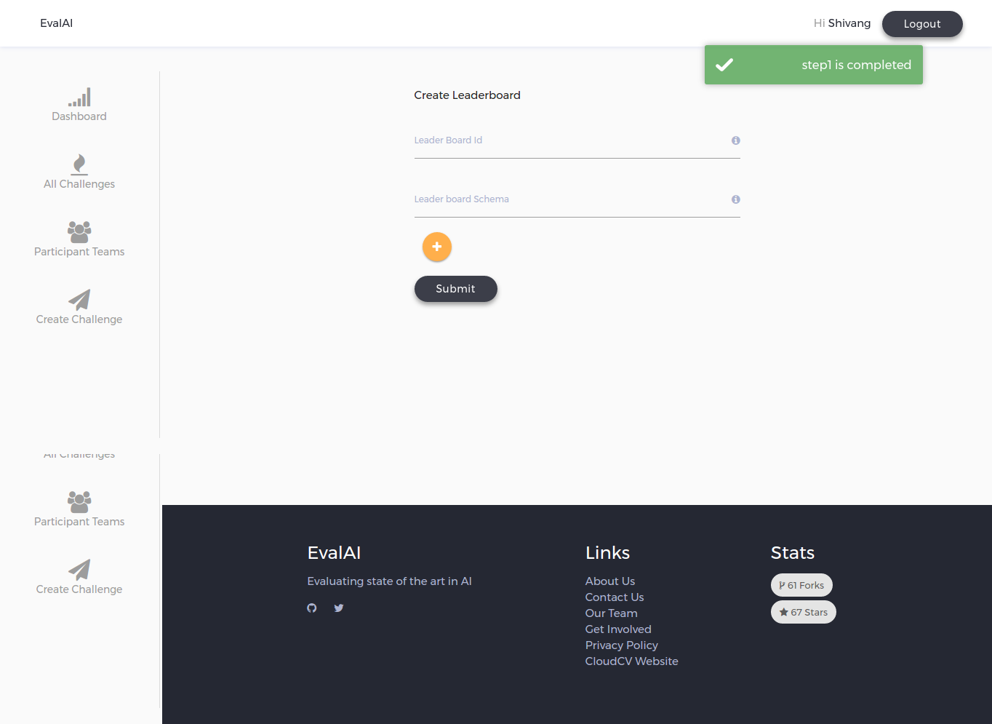
Upcoming features
Challenge Creation on EvalAI
OR
Using zip configuration file
Using intuitive UI (releasing soon)
Notes:
We are working on some really cool features as of now and I would like give an overview of some of those features. The first one is creating challenge on EvalAI. One can create challenge either using zip configuration file or using the intuitive UI of EvalAI.

Slide 19
Upcoming features
Central leaderboard for challenges hosted as third party applications
Challenge X
HTTP POST
(for each submission)
Third party server
EvalAI
Notes:
We are also working on adding support for challenges hosted on third party web applications where they can be linked with EvalAI using a simple web hook service that will publish the results on EvalAI’s leaderboard on the fly. This way, the challenge hosts can restrict the access to the test annotations to themselves and still their challenge can be featured on EvalAI along with all the results.

Slide 20
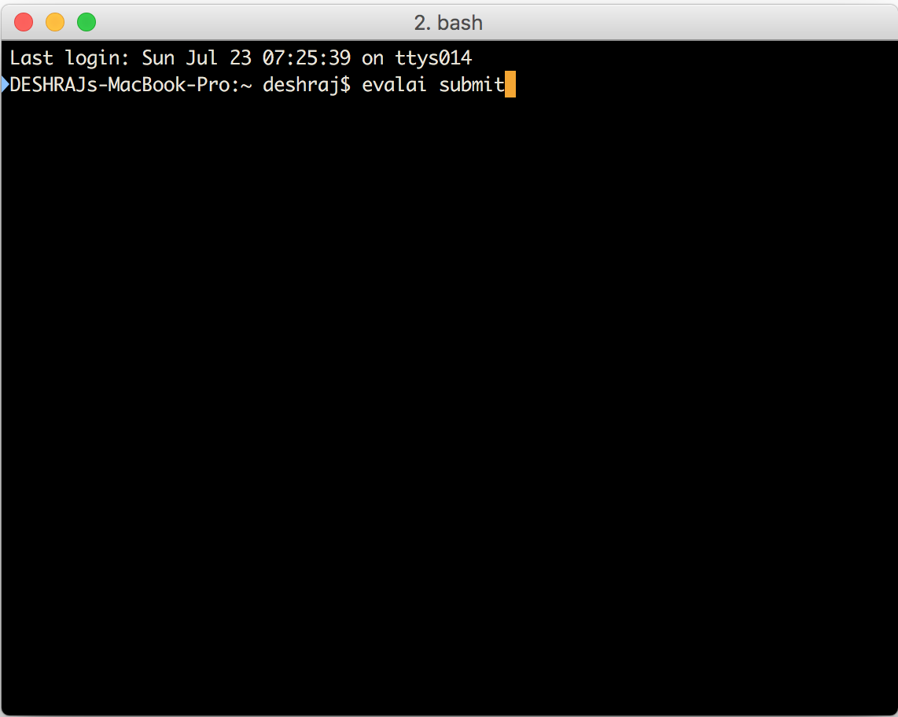
Upcoming features
EvalAI Python APIs
>> import evalai
>> evalai.submit(challenge=“vqa”, data={“foo”: “bar”})
Submission Successful
Participant
Terminal
Notes:
Another important feature is EvalAI Python APIs. Using this, the participants can submit the results to EvalAI through python console.

Slide 21
Summarize
Centralized platform for all AI Challenges
And many more
Notes:
To summarize, our ultimate goal is to build a centralized platform to host, participate and collaborate in AI challenges organized around the globe and we hope to help in benchmarking progress in AI.

Slide 22
Interested in hosting a Challenge?
Reach out to us at team@cloudcv.org
Notes:
If you are interested in hosting a challenge on EvalAI, please reach out to us at team@cloudcv.org

Slide 23
Thank you!
evalai.cloudcv.org
deshraj@cloudcv.org
Notes:
Thats all from my side. Thanks for listening. :)

